Slide 1
Homework 2

Slide 2
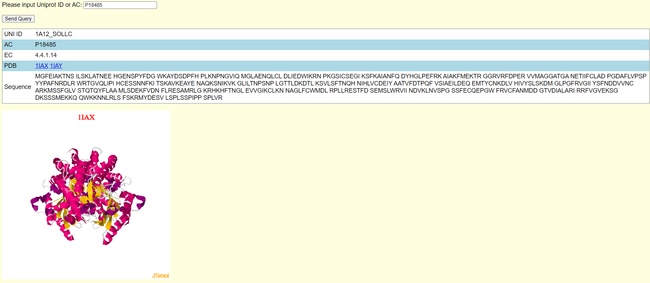
Enzyme database (web)
In homework 1, we create an enzyme database.
In homework 2, please design a web page.
After user input a protein ID (UNI_ID or AC), the page result the detail of the protein, including UNI_ID, AC, EC, PDB and sequence.
User can click "PDB:ID" and the structure displayed by Jmol.

Slide 3
Homework 1
Score
HTML form 20%
Ajax 20%
DB Result (in page)20%
Jmol panel 20%
Display by PDB

Slide 4
Deadline
Deadline
2021/06/16 23:59
Submit
Portal
Filename
s+SID_HW2.html, s+SID_HW2.cgi
e.g : s1001234_HW2.html

Slide 5
Q&A

